Slide 1
KL (Kanade-Lucas) Tracker using Mono and Stereo Footage
Sean Oldenburger

Slide 2
Non-Stereo footage tracking
Input video name: “Non-stereo footage.mp4”
Output video name: “non-stereo tracked.mp4”
Can’t upload this video because it’s too large to add onto git?
Either way next slide is the finished tracking of this video, tracking the calculator perfectly across my room whilst changing in depth, height and width, and moving at faster and slower speeds.

Slide 3
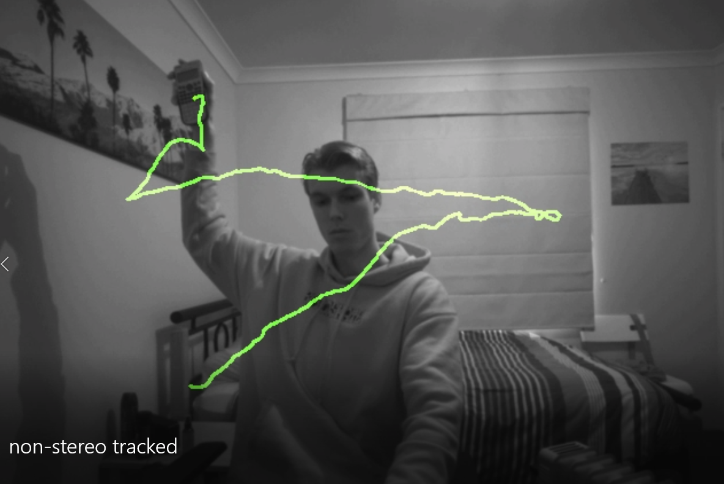

Slide 4
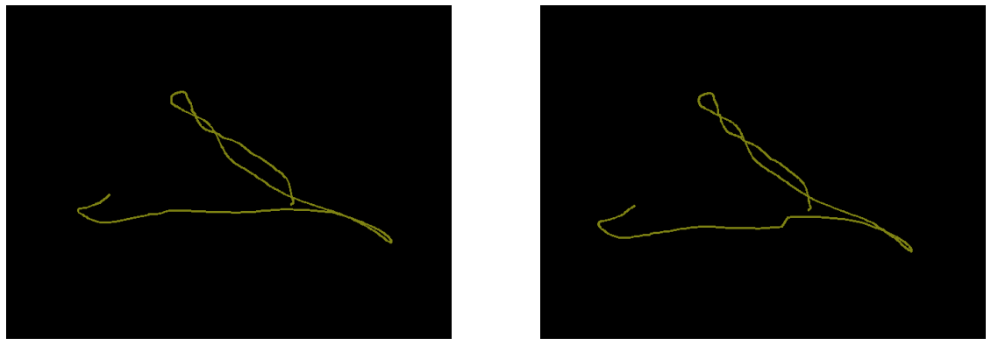
Stereo footage tracking
Video name(s): “stereo footage left/right.mp4”
Output name: “stereo footage tracked.mp4” (has depth colour in tracking path)
Left and right video tracking output (can see the slight changes from their 2 different perspectives) same process as before with the mono tracking now just twice

Slide 5
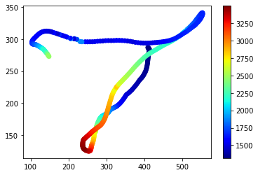
Same tracking but now with depth information found (depth scale in cm), can find disparity between the 2 points on each frame and depth using basic depth = (focal length * baseline)/disparity
Can follow with the video to see that this mapping is indeed correct in relation to the x, y and z(depth) directions

Slide 6
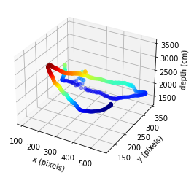
3D graph of the stereo tracking:

